Slide 1
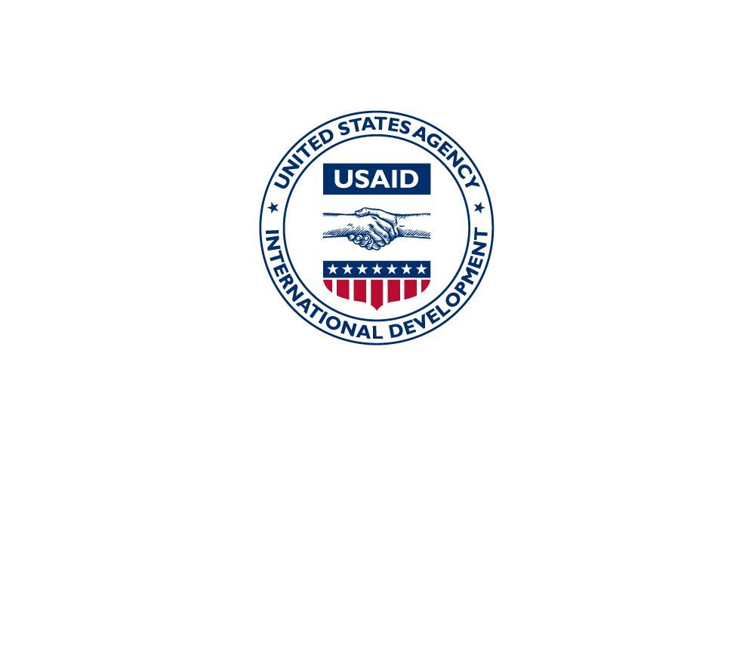
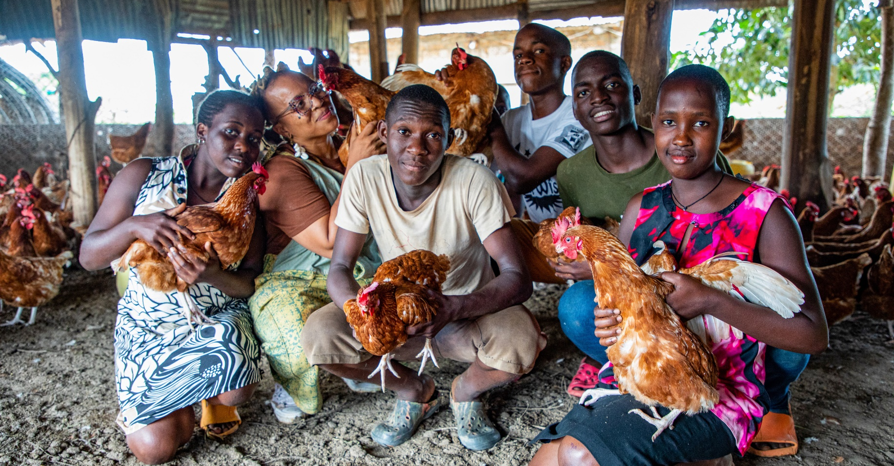
UGANDA
Farmer-to-Farmer Uganda: 2023-2028
QUICK FACTS
Kamwenge
Kitagwenda
Dokolo
Lira
Gulu
Kamuli
Buikwe
Arua
Wakiso
Kalungu
Bushenyi
Kasese
Koboko
Kiboga
Yumbe
Kole
Oyam
Mbarara
Project Location: Uganda
Project Type: Agriculture
Donor: USAID
No. of Participants: 53,110
Value Chains: Agribusiness & livestock
Duration: 2018-2023
Implementing Partners: Farmer’s cooperatives and associations, educational institutions, NGOs, and private agribusinesses.
PROJECT IMPACT
Agribusiness
Livestock
Gross Revenue
Net Income
$2M mobilized
34 new products and services developed
$538K mobilized
22 new products and services developed
Agribusiness: Up from $3.4M at baseline to $4.6M in 2023
Livestock: Up from $3.9M at baseline to $4.7M in 2023
Agribusiness: Up from $750K at baseline to $1.3M in 2023
Livestock: Up from $330K at baseline to $2.4M in 2023
BACKGROUND
Funded by USAID, the Farmer-to-Farmer (F2F)
program connects volunteers from the United States
with agriculture-related organizations in developing
countries. Through two- to four-week assignments,
volunteers provide technical assistance in agricultural
development that supports food security and
sustainable economic growth. They work with local
partners and beneficiaries to increase agricultural
production and productivity, improve business profitability, address environmental and natural
resource management challenges, and improve incomes, thereby contributing to rapid economic growth while conserving environmental and natural resources.
In 2018, CRS was awarded a "Leader with Associate Cooperative Agreement" to implement the F2F program in Rwanda, Benin, Ethiopia, Nepal, Uganda, and Timor-Leste from 2018-2023.
.
HOST PARTNERS ASSISTED
13 Farmers’ cooperatives
3 Educational institutions
6 NGOs
6 Private businesses
Notes:
Add note to this slide

Slide 2
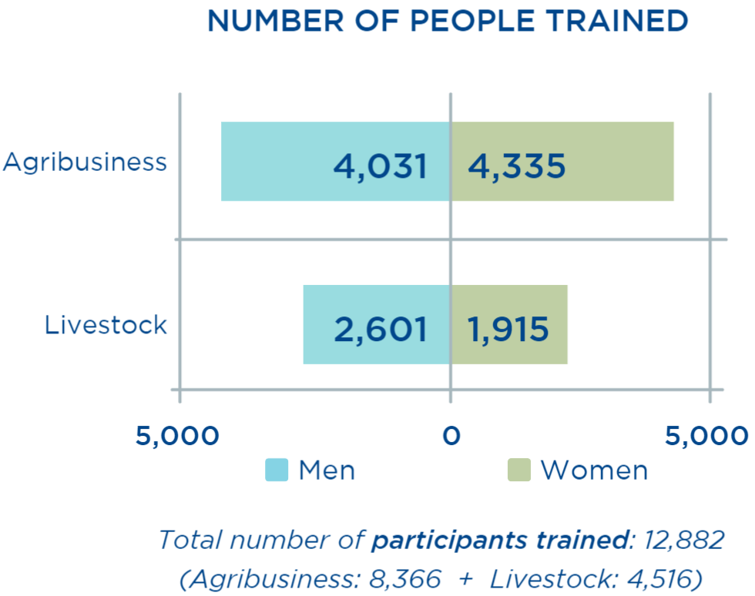
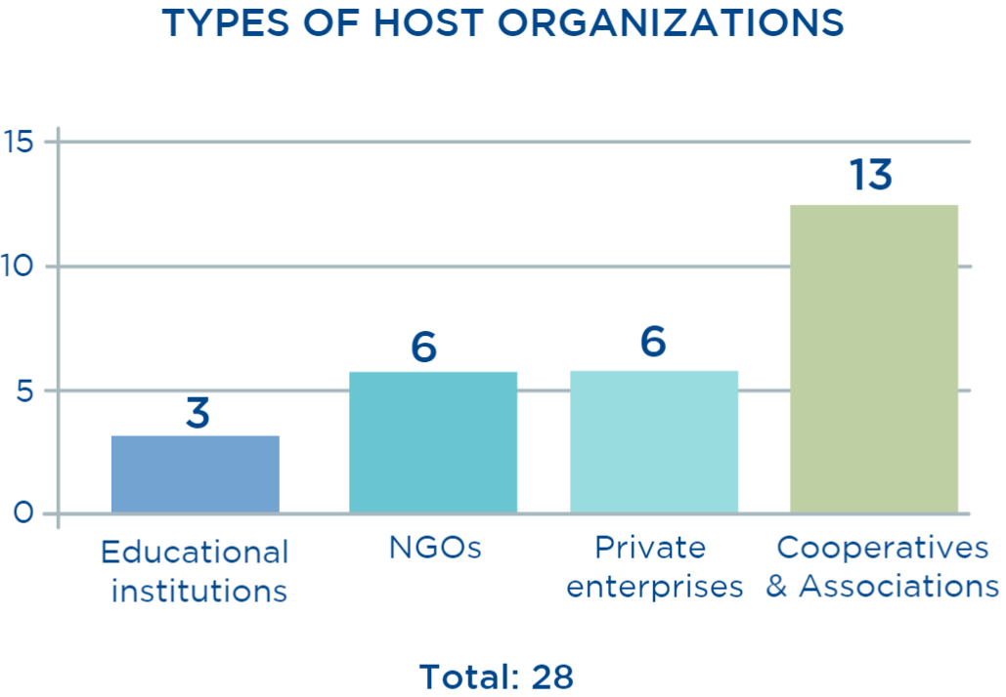
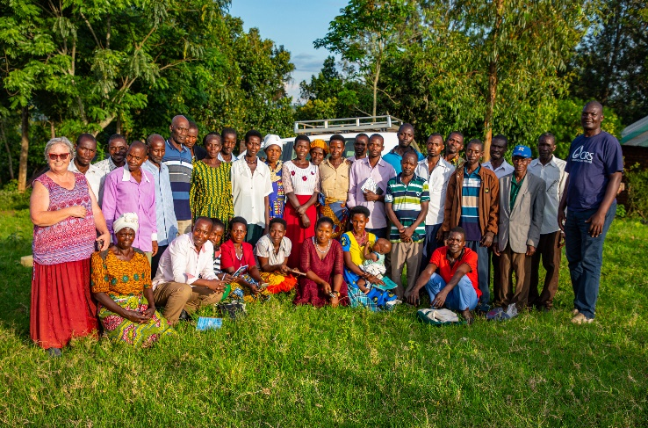
KEY ACHIEVEMENTS
PROJECT GOALS
Facilitate economic growth within targeted subsectors to influence entire value chains.
Enhance sub-sector inclusiveness to support the participation of more individuals and communities.
Increase the U.S. public’s understanding of international development issues and programs, and international understanding of the US and US international development programs.
F2F volunteer Sushil Paudyal (far left) training dairy farmers on animal health management at the Balawoli Kyebaja Tobona Dairy Cooperative Society Ltd. Photo by Mountaga Drame for CRS
F2F IN UGANDA
In consultation with the Government of Uganda and USAID, the CRS F2F program provided technical support to the agribusiness and livestock sub-sectors. As a demand-driven program, F2F volunteer assignments were based on the specific needs of each host organization. Their goal was to improve education, research, and extension capabilities, productivity, access to markets and credit, product processing and value addition, nutritional security and the organizational development of host partners and project participants.
When the COVID-19 pandemic started, US volunteers who were unable to travel provided remote support to local volunteers who directly supported the host partners.
F2F volunteer Pamela Karg (far left) pictured with training participants at the Kamwenge District Farmers Organization, where she trained over 240 people in farmer as a business. Photo by Mountaga Drame for CRS.
CONTACT: George Ntibarikure (george.ntibarikure@crs.org), Uganda F2F Country Director
Banner photo: CRS F2F volunteer DeVonne Jackson (second from left) with students at St. Anthony School for the Deaf, where she provided trainings on backyard gardening methods to teachers, pupils, and support staff. Photo by Mountaga Drame for CRS
Notes:
Type your notes

