Slide 1
Ethiopia Visa Guidance
Have the following before starting your application:
Your passport information
A clear, digital copy of the photo page of your passport
A digital passport photo
The confirmed dates of your trip
CRS’ Ethiopia registration license (Your CRS Operational Specialist contact will provide)
An invitation letter (You CRS Operational Specialist will obtain from CRS Ethiopia colleagues
A credit card for online payment
Click this link to access your online Ethiopian application

Slide 2
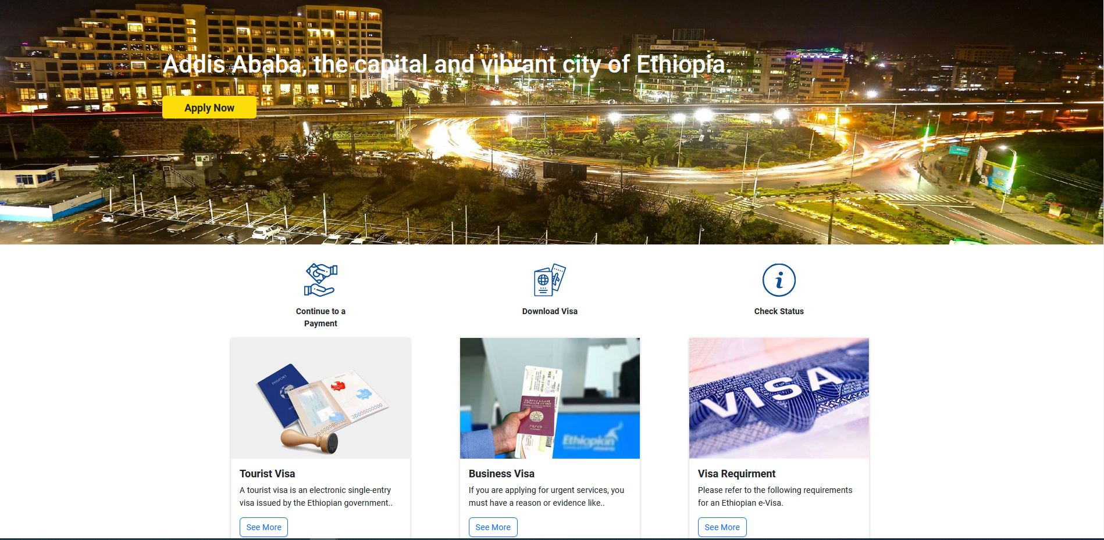
Click Here

Slide 3
Visa Category
Select NGO Visa-NV
Single Entry 30 Days
Include Company Reference number provided by ET Operations Specialist
Note: Your registration confirmation might delay as much as 24 hours. If several hours have passed without confirmation (and you’ve checked junk/spam mail), write to support@evisa.gov.et to inquire.

Slide 4
Arrival information
Use your flight itinerary to fill out this section. Please be very cautious to use the date of entry
Default Hotel is: The Inter Luxury Hotel located in Kazanchis area, Guinea Conakry (Tito) Street, Addis Ababa, Ethiopia.
Note: The hotel may change, please check the information in your invitation letter or ask Operations Specialist for updated hotel information. Use information received to fill out this section.

Slide 5
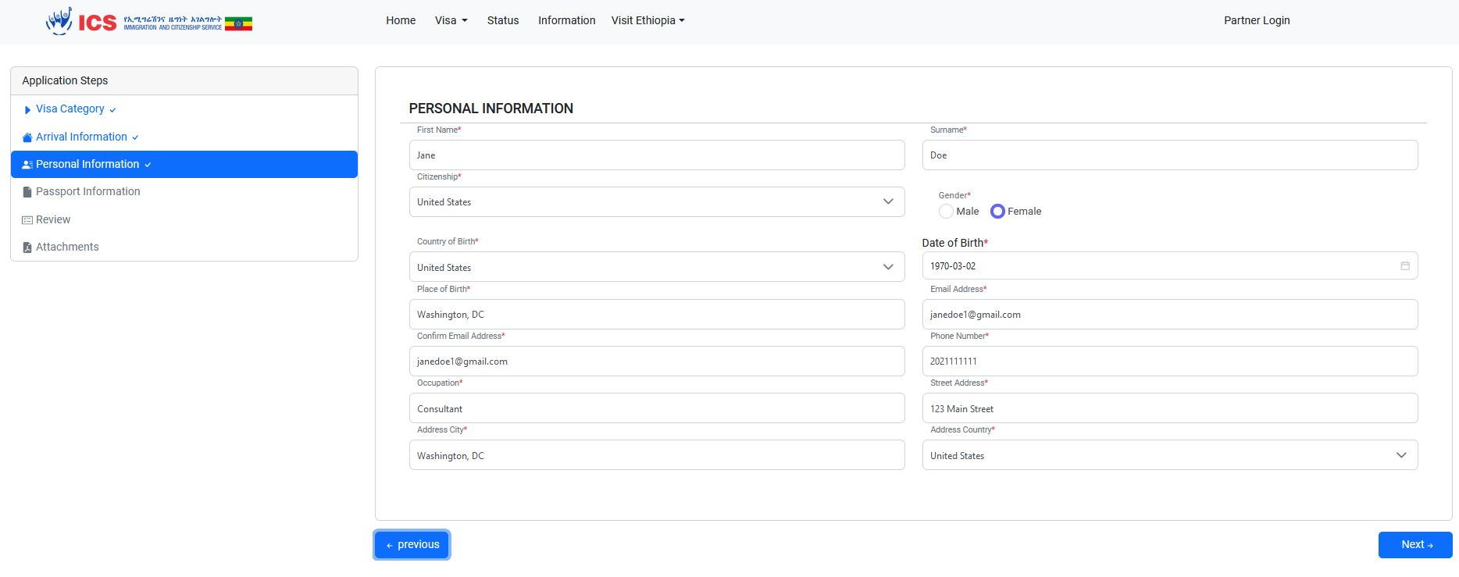
Personal Information
Use your own information to fill out this section
Ensure information matches what is in your passport. Date is in YYYY-MM-DD Format

Slide 6
Passport Information
Ensure you have at least 5 blank visa pages in your passport
Ensure you passport is valid for 6 months or more
Date is in YYYY-MM-DD Format

Slide 7
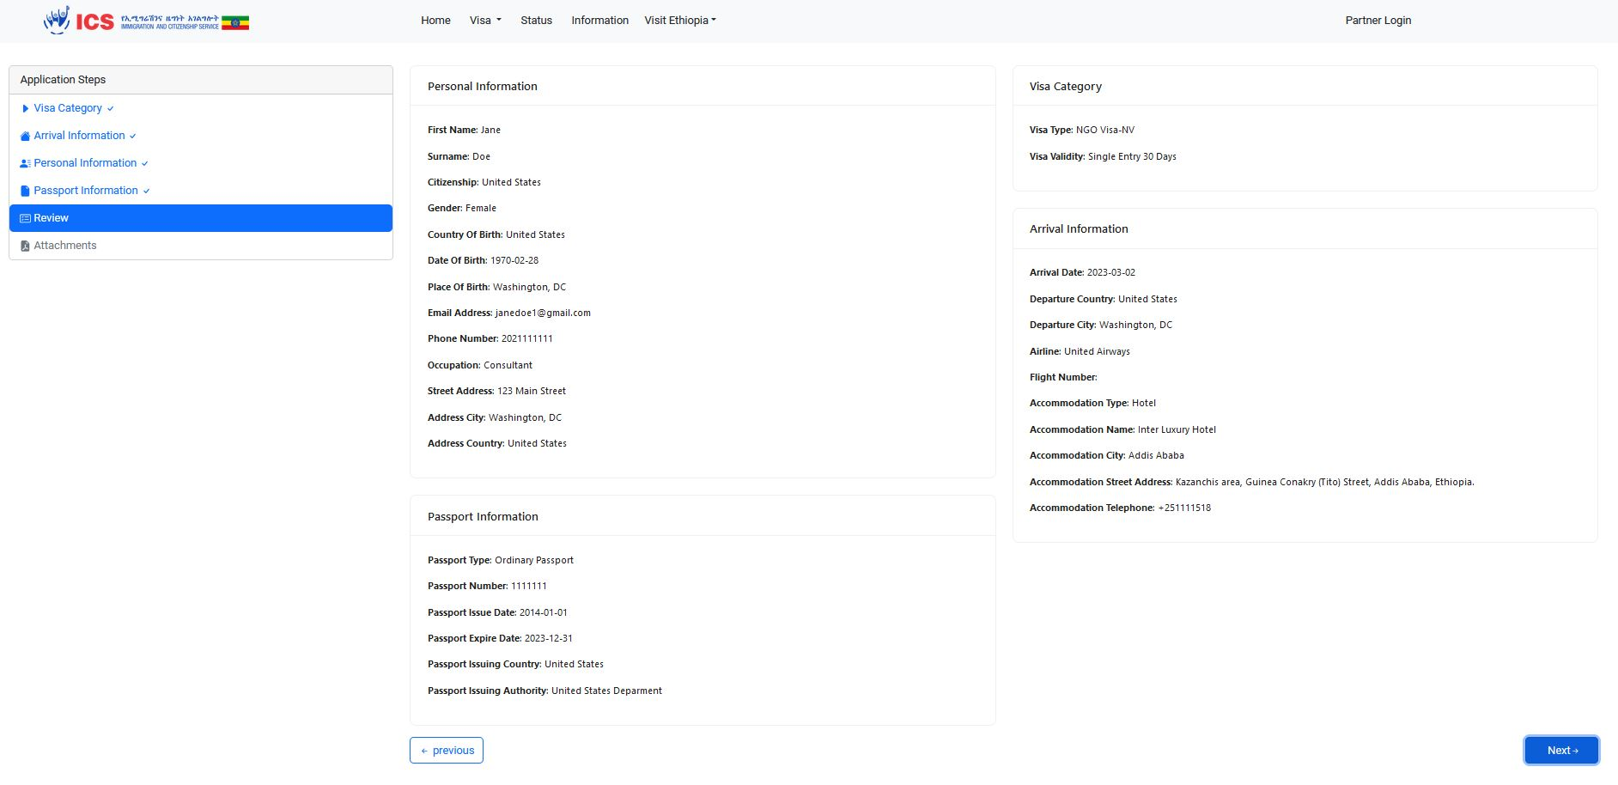
Review
Ensure you have at least 5 blank visa pages in your passport
Ensure you passport is at least valid for 6 more months
Review summary page and select previous if you notice any errors.

Slide 8
Attachments
Ensure you have at least 5 blank visa pages in your passport
Ensure you passport is at least valid for 6 more months
Attach all relevant documents. Note: it is very difficult to fix if you upload documents to the wrong field. Please double check documents before uploading.
The Application letter (i.e., letter of invite) and CRS Registration License are included in your welcome email.
Ensure photo meets the specifications. If too large, screen shot the photo and save as a .jpg or .png to reduce the size.

Slide 9
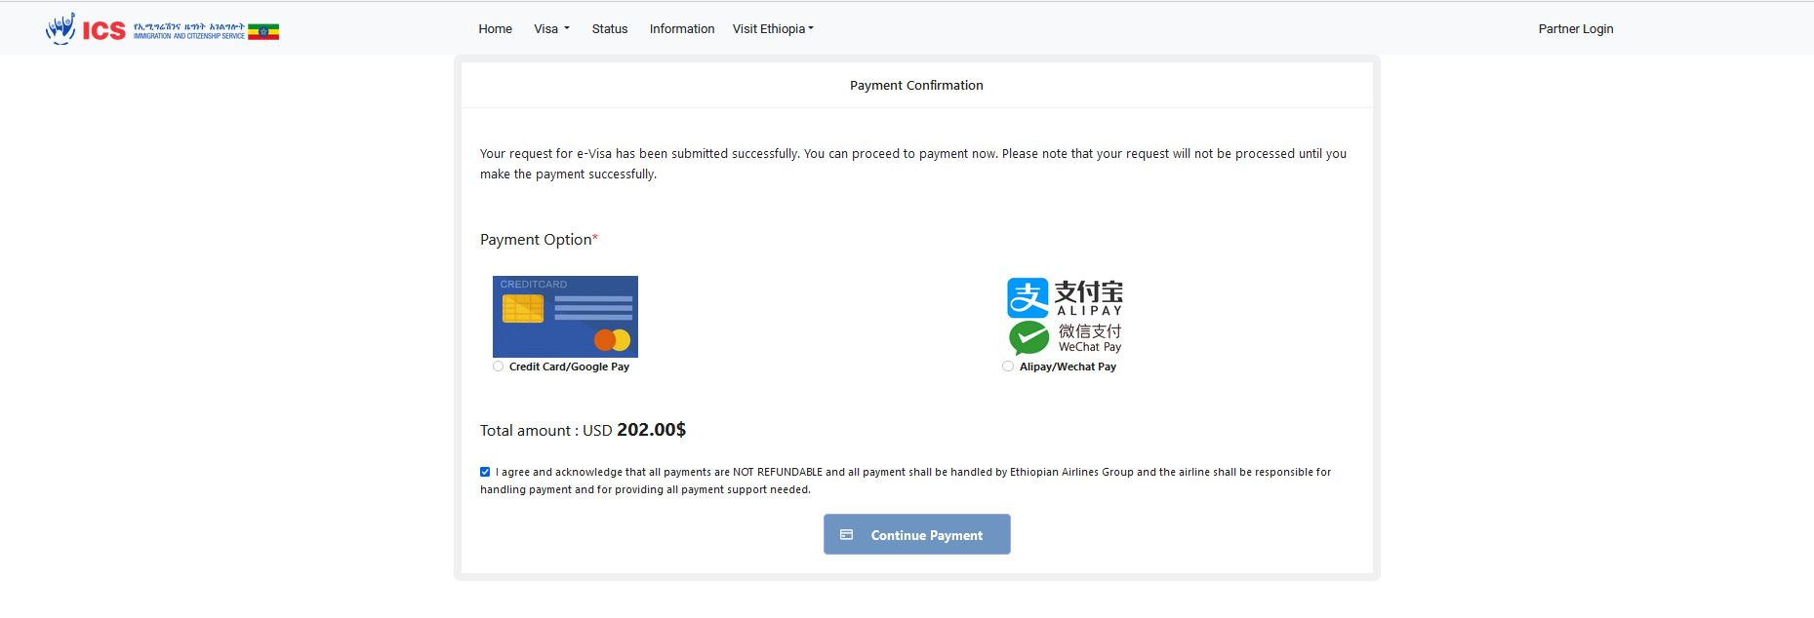
Payment
Select Credit Card/Google Play option
Agree to the terms
Note: The NGO Visa fee has increased from $62 to $202

Slide 10
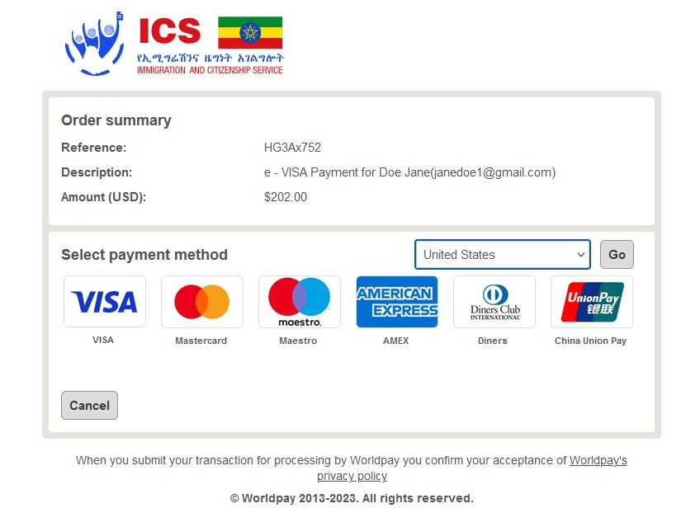
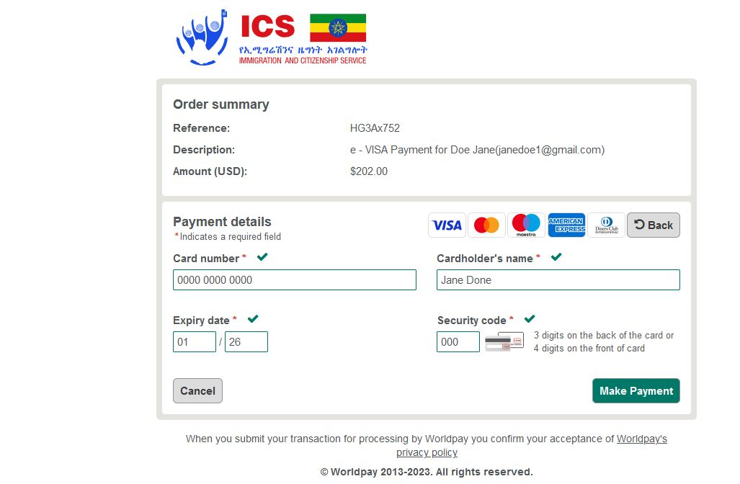
Payment Continued
Select United States in the drop-down menu
Select type of card you will be using
Fill in Card information
Take note of the reference number (HG3Ax752)
Note: The NGO Visa fee has increased from $62 to $202

Slide 11
Payment Continued
Select United States in the drop-down menu
Select type of card you will be using
Fill in Card information
Take note of your reference number (HG3Ax752)
Note: The NGO Visa fee has increased from $62 to $202
Visa takes a few days to obtain 3 – 7 days
This is the final screen.

Slide 12
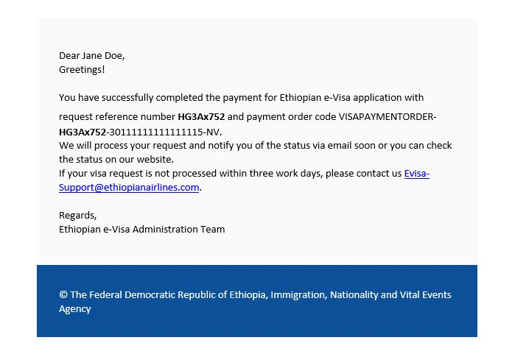
Confirmation E-mails
Expect to received 3 different confirmation emails
Email confirming your application was submitted successfully
Email confirming successful payment with a receipt; Email will be sent from: Evisa-Notification@ethiopianairlines.com
Email confirming visa as been approved
1
2
SAMPLE EMAIL CONFIRMATION
Dear Jane Doe,
You have successfully submitted an application for Ethiopian e-Visa (NGO Work Visa). Your request reference number is HG3Ax752.
We will process your request once you complete the payment successfully and we will notify you of the status via email or you can check the status on our website. We will send a separate confirmation email upon successful completion of your payment. In case you face issues while making payment, click here to try the payment again. If you are unable to click the link, copy and paste the URL https://www.evisa.gov.et/apply/confirmrequest?code=202302030453099078a819-a847-4a65-8ffa-ef99639b25e4 on to your browser. The payment link will expire in 48 hours. PLEASE DO NOT REPLY TO THIS EMAIL AS IT IS FROM AN UNMONITORED ACCOUNT. If your visa request is not processed within three working days, please contact us at Evisa-Support@ethiopianairlines.com.
Note: Unfortunately, it is difficult to get support via email. If 72 hours have passed and you have not received your visa email the support email and reach out to your Operations Specialist.

Slide 13
Confirmation E-mails
3
This email will come from nonreply@evisa.gov.et. Check junk/spam folder.
It will include your e-visa in a pdf attachment which you are required to download.
The PDF is an e-visa which summarizes all your relevant passport and travel information, including visa type, reference code, visa validity type and dates and your passport picture.

Slide 14
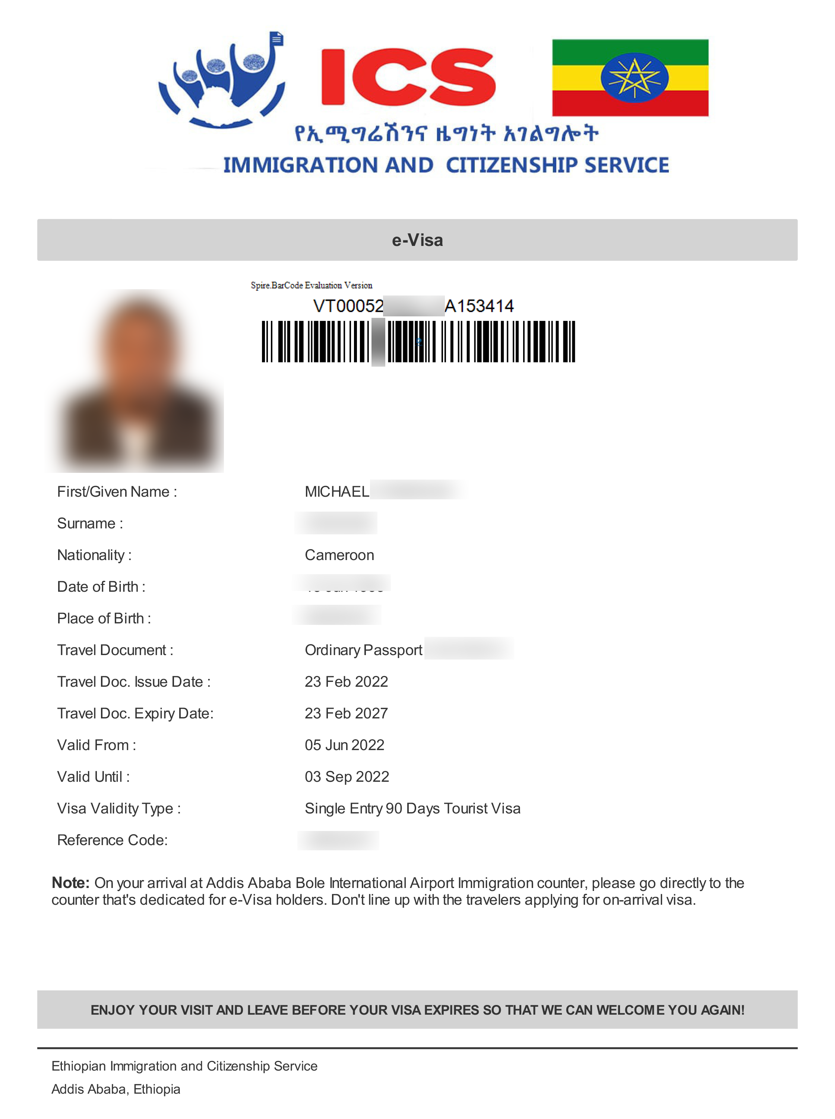
Sample E-Visa
Sample E-visa
Download and print a copy for your travels

Slide 15
Traveling
When traveling ensure you have print outs of all the relevant documents:
E-visa
E-visa Receipt
Letter of invitation
Covid-19 Vaccination Card

