Slide 1
Ethiopia Visa Guidance
Before you start, you should have
Your passport information
A clear, digital copy of the photo page of your passport
A digital passport photo
The confirmed dates of your trip
CRS’ Ethiopia registration license (Your CRS recruiter contact can provide)
An invitation letter (You CRS recruiter can obtain from CRS Ethiopia colleagues
A credit card for online payment
Click this link to access your online Ethiopian application

Slide 2
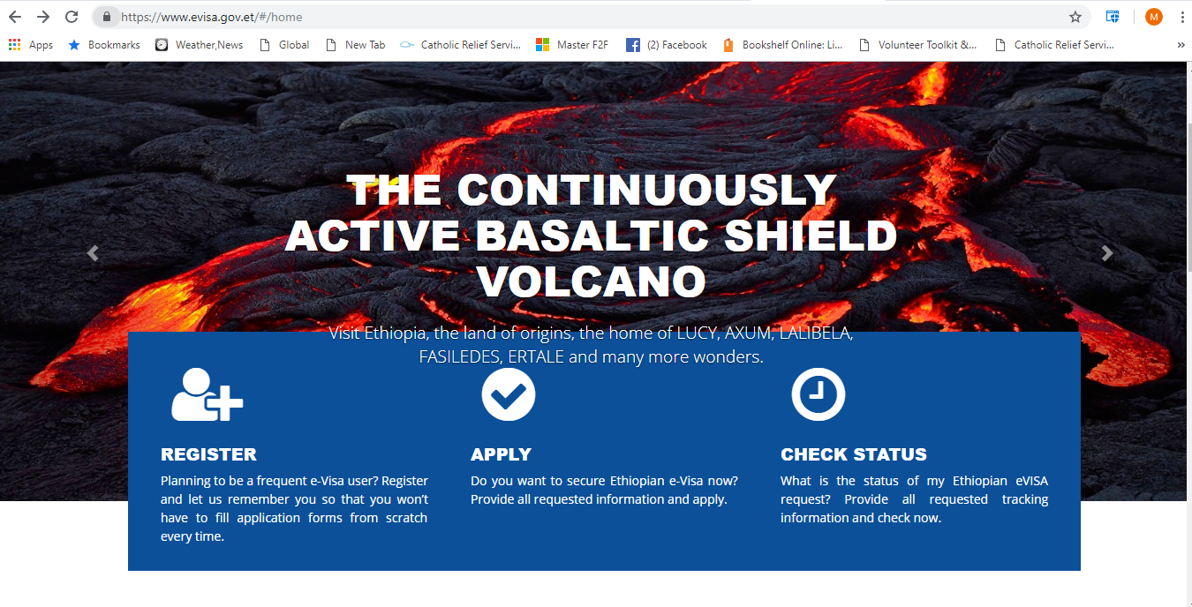
Click Here

Slide 3
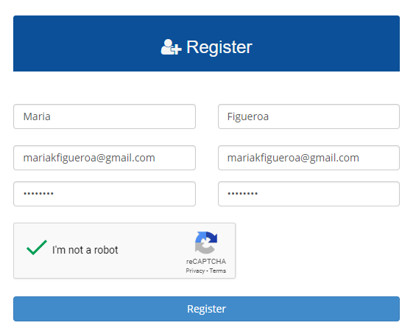
Register for a visa account
-Fill in your information as shown in this example
-Click the “register” button
Note: Your registration confirmation might delay as much as 24 hours. If several hours have passed without confirmation (and you’ve checked junkmail), write to support@evisa.gov.et to inquire.

Slide 4
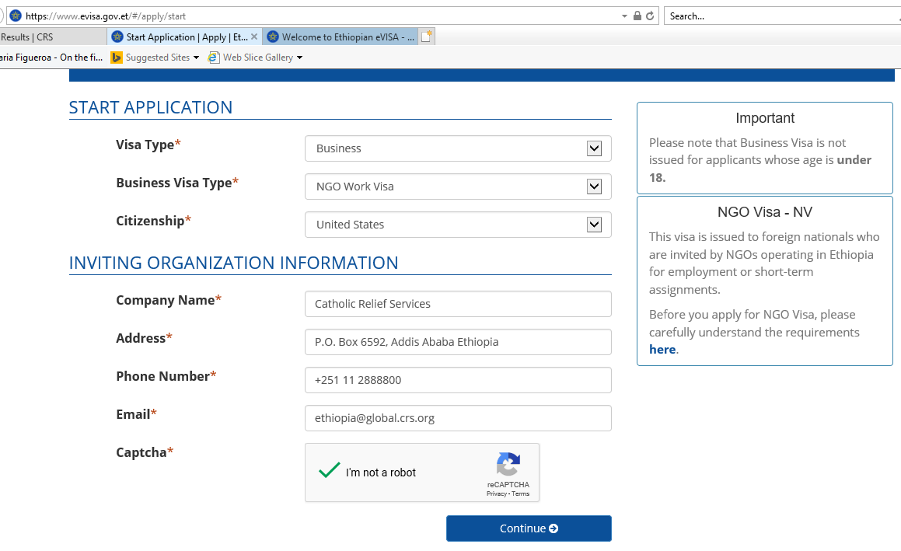
Please use the exact information shown in this example to fill out your own application

Slide 5
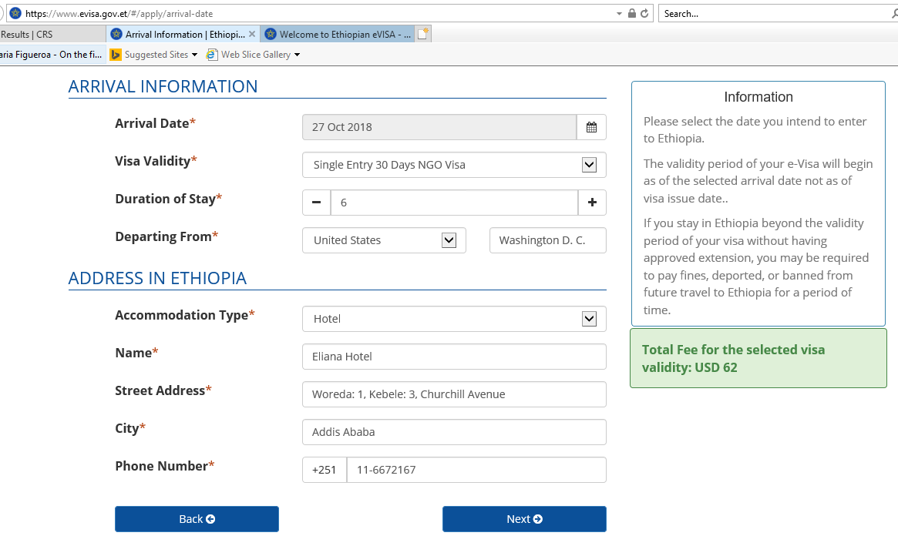
Use your flight itinerary to fill out this section. Please be very cautious to use the right date
Please check the information in your invitation letter and use that to fill out this section

Slide 6
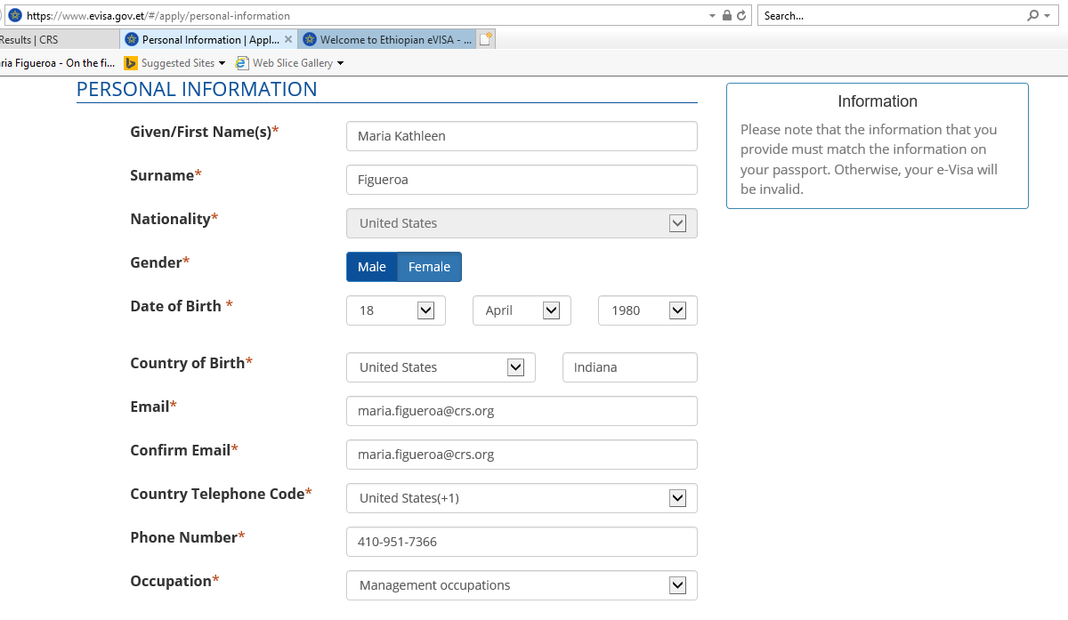
Please use your own personal information to fill out this section

Slide 7
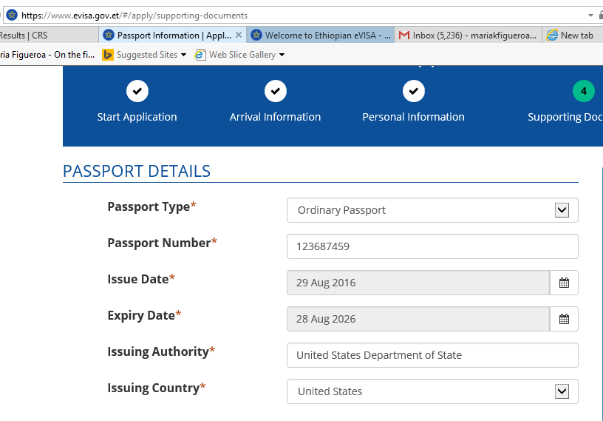
Please use your own personal information to fill out this section

Slide 8
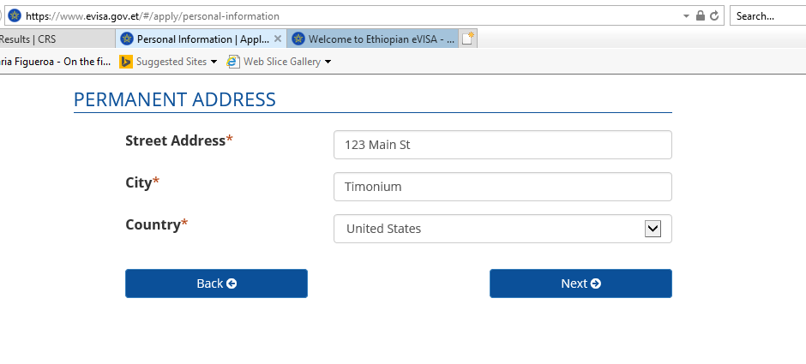
Please use your own personal information to fill out this section

Slide 9
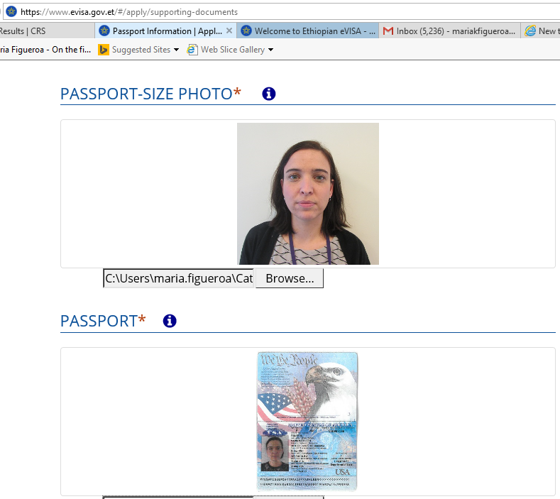
Upload your passport photo and passport copy here.
Note: it is very difficult to fix if you upload documents to the wrong field. Please double check before uploading

Slide 10
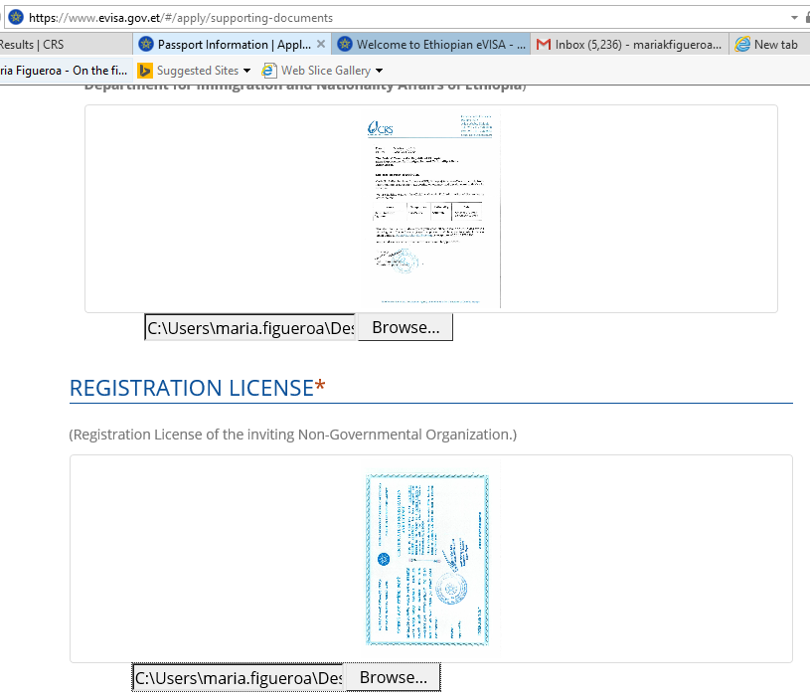
Upload your invitation letter and CRS Ethiopia registration license
Note: it is very difficult to fix if you upload documents to the wrong field. Please double check before uploading

Slide 11
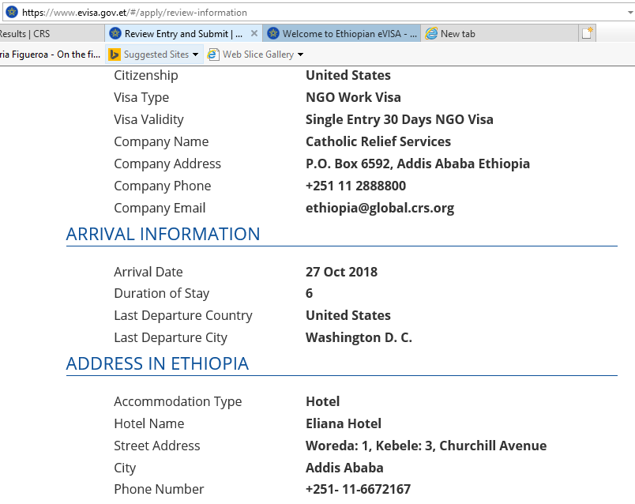
Here you review your information before submitting.

Slide 12
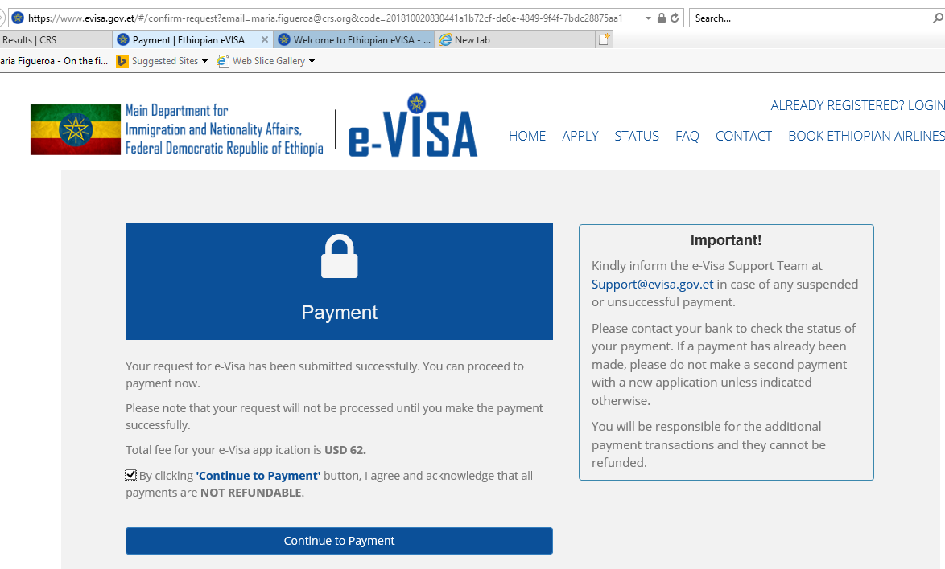
Here you will click to continue to the payment screen

Slide 13
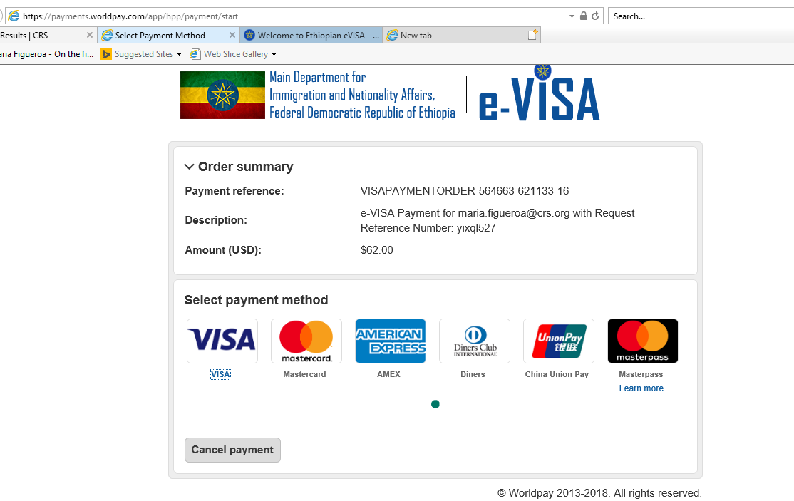
Click on your desired payment method

Slide 14
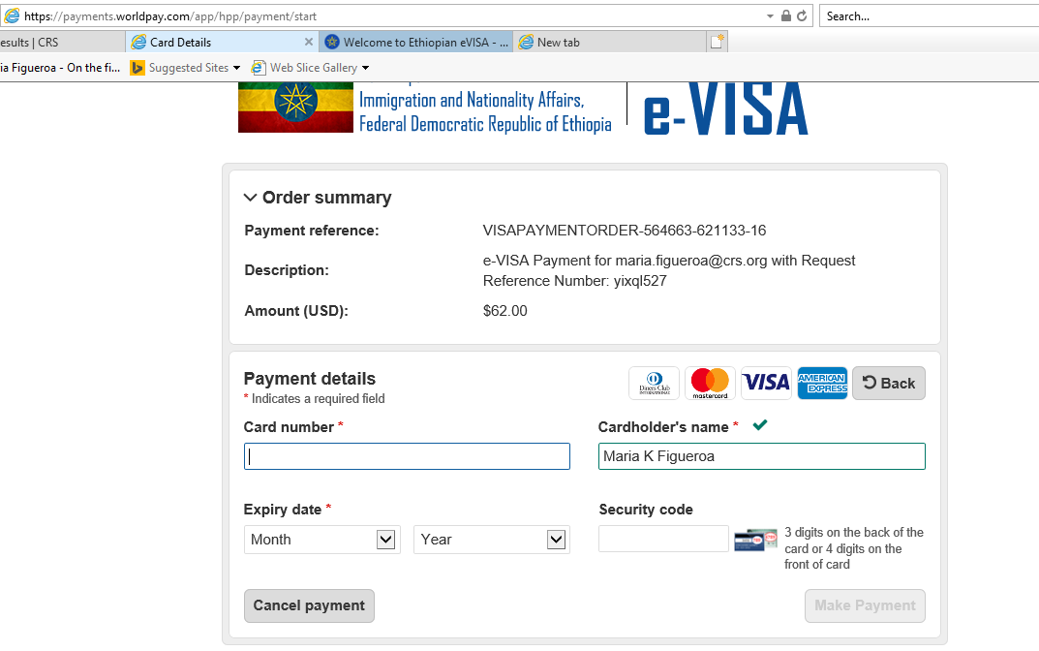
Enter your payment information here.
Note: CRS advances $62 to cover your visa, along with your per diem, prior to your assignment.

Slide 15
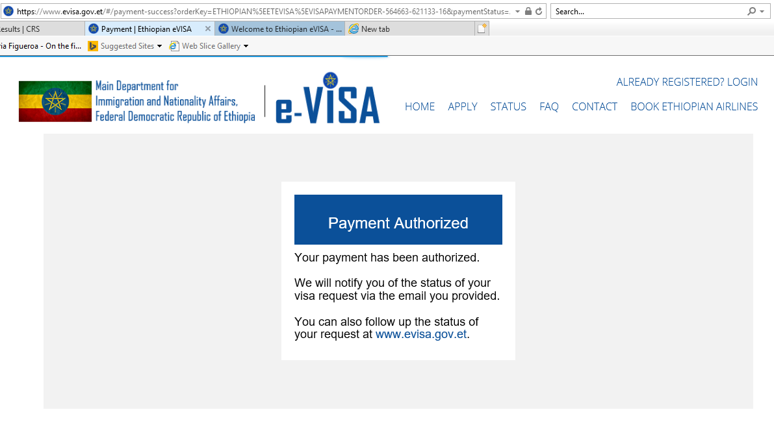
This is the final screen. Your visa might come in as little as a few hours; or it may take a few dars

